Slide 1
Temperature Dependence of Thermal Conductivity for Water Using the Transient Hot-Wire Method

Slide 2
Introduction
Transient Hot-Wire Method:
A widely used experimental technique that employs a very thin wire as a linear heat source to calculate thermal conductivity by analyzing the relationship between temperature rise and the logarithm of time.
Assumes heat diffusion in a stationary fluid medium, requiring minimal influence from convection for reliable results.
Objectives of this Study:
Expand Thermal Conductivity Data Near the Freezing Point: Provide experimental data for water's thermal conductivity in the 273–305 K range, where prior data is scarce.
Minimize Convection Effects: Improve data processing techniques to reduce experimental errors caused by natural convection.
Present New Findings: Report the non-monotonic behavior of thermal conductivity near the freezing point, a phenomenon not observed in previous studies.
Notes:
The transient hot-wire method is a widely used experimental technique for measuring thermal conductivity. It uses a thin wire as a heat source, analyzing the temperature rise as a function of time to calculate thermal conductivity. The method assumes a stationary fluid medium for accurate results, but convection can compromise this assumption and reduce the reliability of the measurements. Therefore, minimizing convection is a critical challenge in applying this method.
This study aims to measure the thermal conductivity of water in the temperature range of 273 to 305 K, specifically near the freezing point where data has been limited. The objectives include expanding thermal conductivity data in this underexplored range, minimizing the impact of convection through improved data processing, and presenting a novel finding: the non-monotonic behavior of water's thermal conductivity near the freezing point. This work provides new insights into the thermal properties of water and enhances our understanding of fluid behavior in this temperature range.

Slide 3
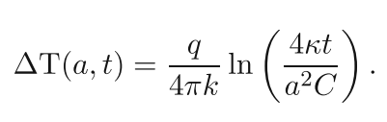
Methodology
Definition
The transient hot-wire method is an experimental technique based on analyzing radial heat diffusion generated by a linear heat source in an infinite solid medium.
In practice, a very thin platinum wire is used to approximate the ideal configuration.
Principle
The wire is heated with a constant current, and the resulting temperature rise over time and distance is measured to calculate thermal conductivity.
The temperature rise at the wire surface is expressed as:
Notes:
The transient hot-wire method is a widely used technique for measuring thermal conductivity. It analyzes the heat diffusion generated by a linear heat source in an infinite medium. In this experiment, a very thin platinum wire is used as the heat source, heated with a constant current. The temperature rise over time is measured, and the relationship is described by the following equation.

Slide 4
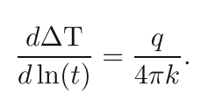
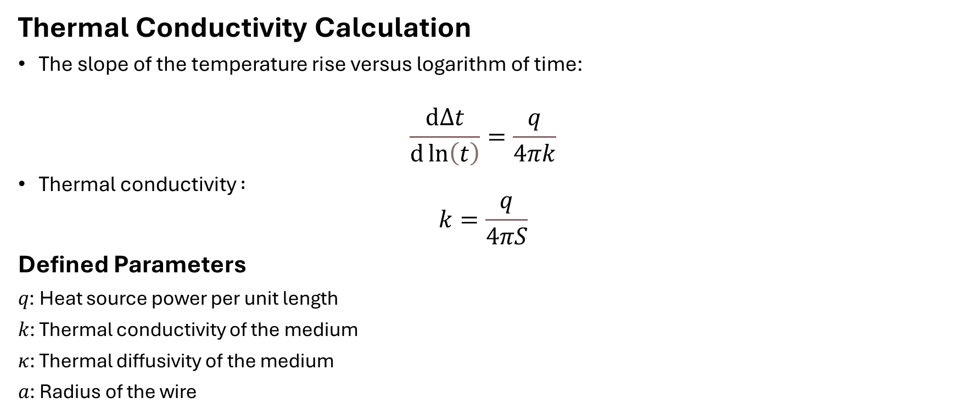
Methodology
Thermal Conductivity Calculation
The slope of the temperature rise versus logarithm of time:
$$\frac{ⅆΔt}{ⅆ\ln\left(t\right)}=\frac{q}{4πk}$$
Thermal conductivity $:$
$$k=\frac{q}{4πS}$$
Defined Parameters
𝑞: Heat source power per unit length
𝑘: Thermal conductivity of the medium
𝜅: Thermal diffusivity of the medium
𝑎: Radius of the wire
Notes:
By calculating the slope of the temperature rise versus the logarithm of time, we can determine the thermal conductivity of the medium. The calculation involves key parameters such as the heat source power, thermal diffusivity, and wire dimensions, enabling effective analysis of experimental data.

Slide 5
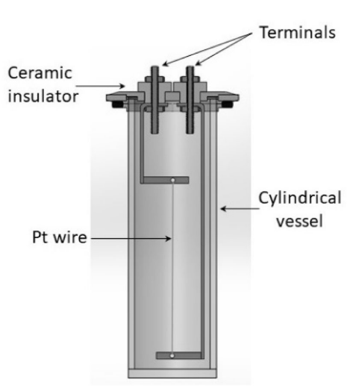
Experimental Setup
Experimental cell:
Stainless steel with a diameter of 43mm and a length of 150mm
Platinum wire:
Radius of 25μm, length of 95.33mm, and 99.99% purity
Measurement equipment:
Keithley 2440 Sourcemeter and 24-bit A/D converter
Notes:
The experimental setup consists of three main components. First, the experimental cell is made of stainless steel with a diameter of 43mm and a length of 150mm. This provides a stable environment for the measurements.
Second, the platinum wire, which acts as the linear heat source, has a radius of 25μm, a length of 95.33mm, and a purity of 99.99%. These specifications ensure high accuracy and minimal experimental error.
Finally, the measurements are performed using the Keithley 2440 Sourcemeter and a 24-bit A/D converter to precisely monitor resistance and voltage changes during the experiment.

Slide 6
Measurement Procedure
Submerge the platinum wire completely in the experimental cell filled with distilled water.
Place the experimental cell in a temperature-controlled bath and allow it to stabilize at the initial temperature.
Apply a constant current to the wire to initiate heating.
Record the temperature rise on the wire surface over time.
Analyze the collected data to calculate the thermal conductivity.
Notes:
The measurement procedure follows these steps:
Step 1: The platinum wire is completely submerged in the experimental cell filled with distilled water. This ensures that the wire is in full contact with the experimental medium.
Step 2: The experimental cell is placed in a temperature-controlled bath and left to stabilize until the wire and the medium reach the same initial temperature. This step is critical for ensuring accurate measurements.
Step 3: A constant current is applied to the wire to initiate heating. The current remains steady throughout the measurement process, creating a controlled thermal environment.
Step 4: The temperature rise on the wire surface is recorded over time with high precision. This data is essential for analyzing the heat transfer properties of the medium.
Step 5: Finally, the collected data is analyzed to calculate the thermal conductivity. The transient hot-wire method equations are applied to derive the results.
This procedure is designed to maintain precision at every stage and ensure the reliability of the experimental data.

Slide 7
Experimental Specifications
Temperature Calibration:
The experimental setup uses two temperature sensors for precise temperature control.
A standard sensor and one attached to the experimental cell ensure the temperature is maintained within ±0.01°C accuracy.
Prior to the experiment, the temperature of the bath is set to 25°C and adjusted to remain constant throughout the experiment.
Data Acquisition:
Data is collected using a high-speed analog-to-digital converter (A/D converter).
Voltage and temperature data are sampled every second to precisely track the temperature change during the experiment.
Each experiment lasts a minimum of 10 minutes, and the collected data is used to calculate thermal conductivity.
Notes:
Temperature calibration is a crucial part of the experiment. Two temperature sensors are placed in the experimental cell and temperature-controlled bath to ensure accurate temperature regulation. These sensors maintain a precision of ±0.01°C, and the bath temperature is set to 25°C before the experiment starts, with constant adjustments to maintain that temperature throughout the experiment.
Data acquisition is done using a high-speed analog-to-digital converter (A/D converter), which samples voltage and temperature data every second. Each experiment runs for at least 10 minutes, and the collected data is used to precisely track the temperature rise, which is then used to calculate the thermal conductivity.

Slide 8
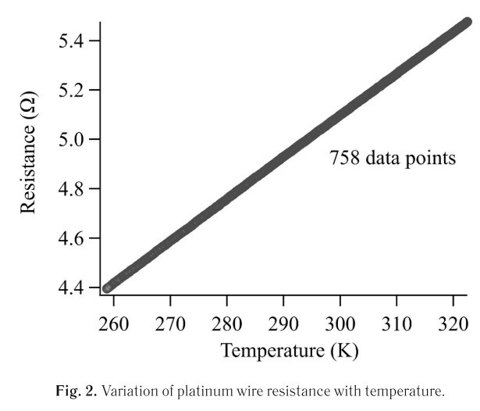
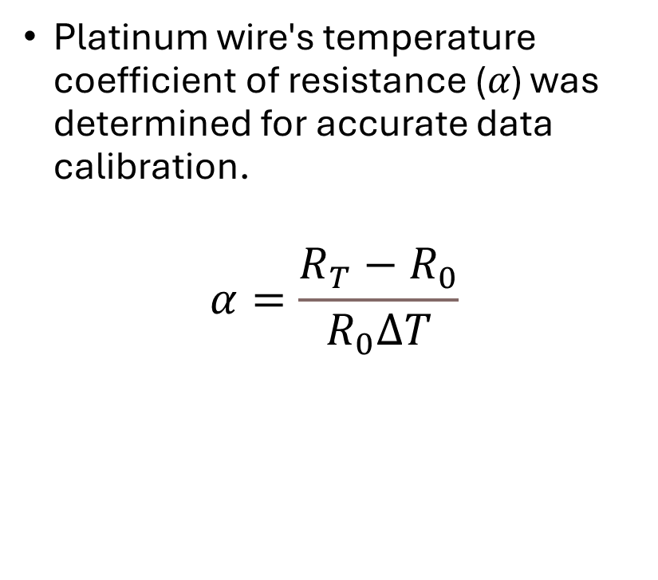
Determination of Temperature Coefficient of Resistance
Platinum wire's temperature coefficient of resistance (𝛼) was determined for accurate data calibration.
$$α=\frac{R_{T}−R_{0}}{R_{0}ΔT}$$
Notes:
The accurate calculation of thermal conductivity using the transient hot-wire method requires precise determination of the platinum wire’s temperature coefficient of resistance. Fig. 2 illustrates the linear relationship between the wire’s resistance and temperature. The results align closely with the values reported in the literature, confirming the reliability of the measured data.

Slide 9
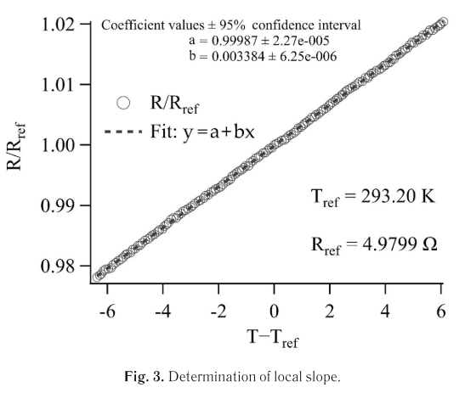

Thermal Conductivity Calculation
Thermal Conductivity Calculation
$$k=\frac{q}{4πS}$$
Notes:
Fig. 3 shows the relationship between the logarithm of time and the temperature rise during the experiment. The slope (SSS) of the linear region of this graph is critical for calculating the thermal conductivity (kkk) using the given formula. This approach allows us to derive accurate thermal conductivity values based on the experimental data.

Slide 10
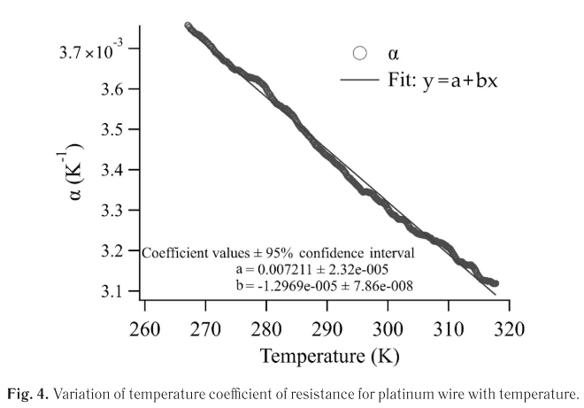
Relationship Between Temperature and Temperature Coefficient of Resistance
Notes:
Fig. 4 illustrates the relationship between the temperature coefficient of resistance and temperature for the platinum wire. The coefficient peaks near 273K, reflecting its highest sensitivity to temperature changes. As the temperature increases beyond this point, α\alphaα shows a decreasing trend. These findings align with the known properties of platinum and are critical for accurate thermal conductivity calculations.

Slide 11
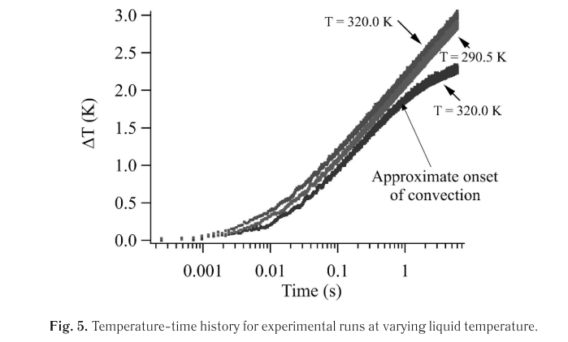
Temperature-Time History
Notes:
Fig. 5 illustrates the temperature-time history recorded during the experiments for various liquid temperatures. The graph highlights three distinct regions: the initial nonlinear phase, the linear phase, and the convection-dominated phase. The linear region is selected to extract the slope used for thermal conductivity calculations.

Slide 12
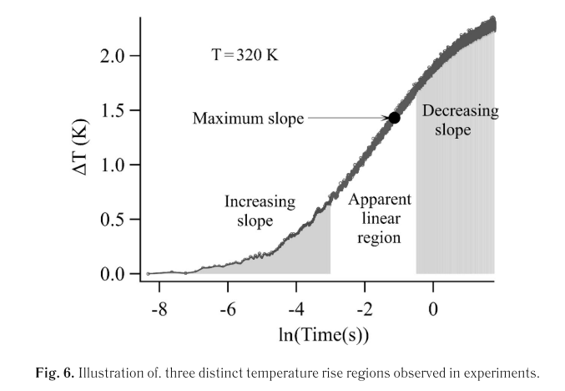
Three Distinct Regions in Temperature Rise
Notes:
Fig. 6 categorizes the temperature rise data into three distinct regions observed during the experiments. The nonlinear region is influenced by the wire's finite heat capacity. The linear region represents ideal heat transfer conditions for thermal conductivity calculations. Finally, the convection region shows the impact of natural convection on temperature rise.

Slide 13
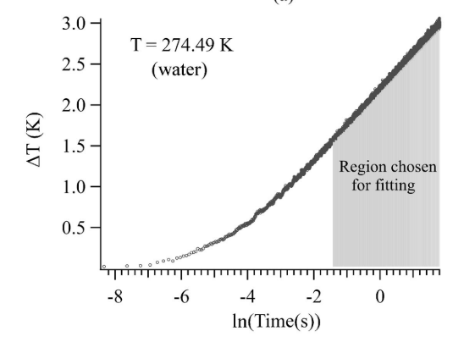
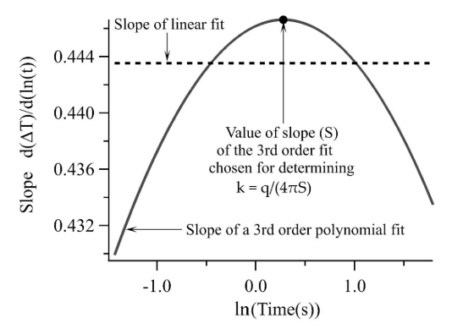
Slope Determination for Thermal Conductivity
Notes:
Fig. 7 illustrates the process of determining the slope for thermal conductivity calculations. In (a), the experimental linear region is identified and fitted. In (b), the comparison between the linear and third-order polynomial fits is shown. The filled symbol represents the slope used in the final determination of thermal conductivity.

Slide 14
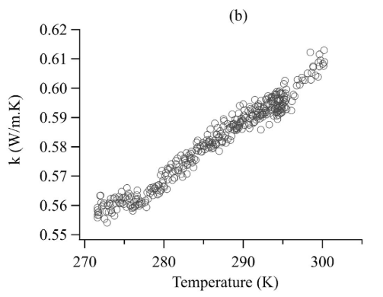
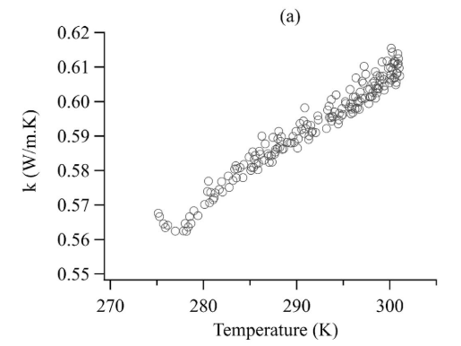
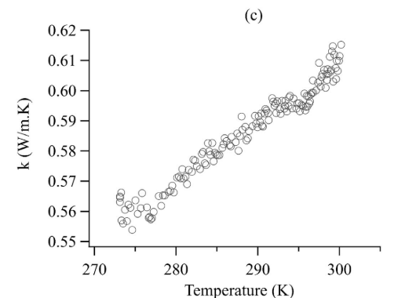
Thermal Conductivity Variation with Temperature
Notes:
Fig. 8 presents the thermal conductivity variation with temperature from three independent experimental runs. In all cases, thermal conductivity increases with temperature. However, at higher temperatures, data scatter becomes more pronounced, likely due to minor differences in experimental conditions.

Slide 15
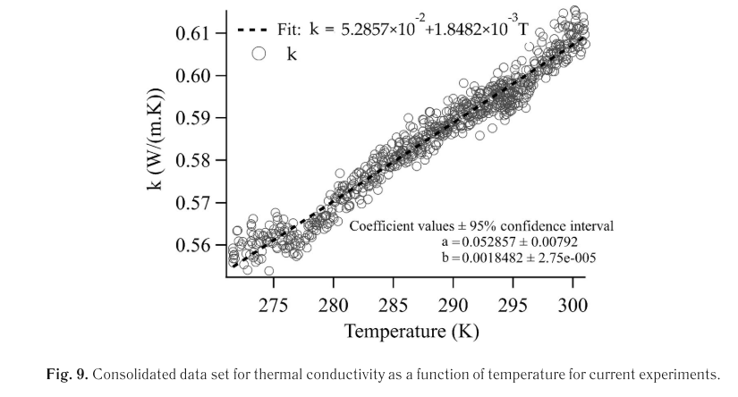
Consolidated Thermal Conductivity Data
Notes:
Fig. 9 consolidates data from the three experimental runs to illustrate the overall variation of thermal conductivity with temperature. A local minimum is observed near 276.89K, highlighting an intriguing deviation in thermal behavior. This consolidated graph confirms the consistency of the experimental results.

Slide 16
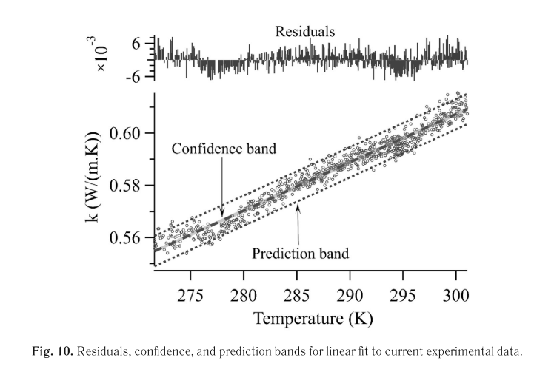
Residual Analysis
Notes:
"Fig. 10 presents the residual analysis for the experimental data. The largest residual is observed near 4°C, providing insight into potential discrepancies in the model fit. Confidence and prediction bands are included to further validate the reliability of the regression model.

Slide 17
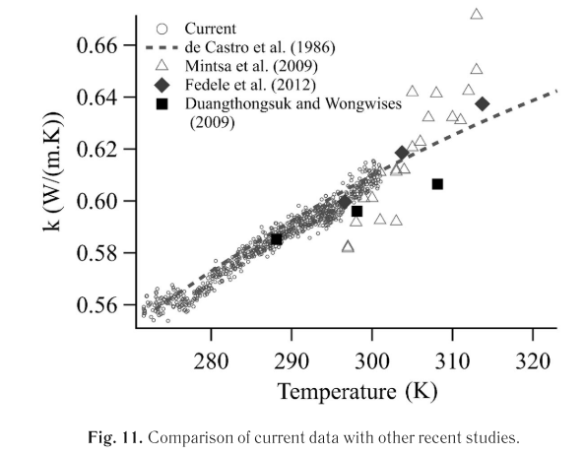
Comparison with Literature Data
Notes:
Fig. 11 compares the current experimental results with data from previous studies. The experimental results align well with existing literature, with deviations within ±5%. This comparison strengthens the reliability of the current findings and their alignment with established knowledge.

Slide 18
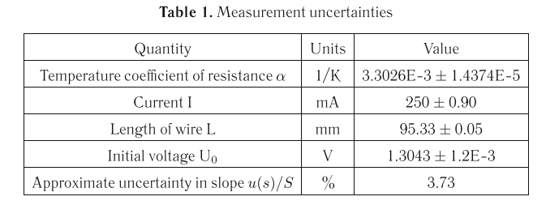
Summary of Key Experimental Data
Notes:
Table 1 summarizes the key experimental data, including temperature, thermal conductivity, slope (SSS), and error percentages. The results highlight the local minimum observed at 276.89K, while maintaining an error range within ±2–3%, ensuring the reliability of the measurements

Slide 19
Results
Measurement Range:
Thermal conductivity of water was experimentally measured over the range of 273K to 301K.
Key Findings:
Thermal conductivity generally increases with temperature.
A local minimum was observed at 276.89K (3.74°C).
This non-monotonic behavior has not been reported in prior literature.
Reproducibility and Reliability:
Data from three independent experiments were consolidated, ensuring high reliability.
Results match reference data within ±5%.
Notes:
The experimental results show how the thermal conductivity of water varies with temperature in the range of 273K to 301K. Notably, a local minimum in thermal conductivity was observed at approximately 276.89K, which is a novel finding not reported in prior studies. The three independent experimental datasets exhibit high reproducibility and align with reference data within ±5%.

Slide 20
Conclusions
Transient Hot-Wire Method:
Proven effective for measuring the thermal conductivity of water, even at low temperatures.
Key Discoveries:
Thermal conductivity exhibits non-monotonic behavior, with a local minimum at 276.89K.
This anomalous trend has not been previously documented.
Significance:
Accurate measurement of the temperature coefficient of resistance for the platinum wire is critical for analysis.
A method was proposed to minimize user bias when determining the slope from the temperature rise vs. log-time graph.
Notes:
This study successfully used the transient hot-wire method to measure the thermal conductivity of water, identifying a local minimum at approximately 276.89K. This anomalous trend is a novel finding that has not been documented in prior studies. Accurate measurement of the platinum wire's temperature coefficient of resistance was essential to ensure reliable results. Additionally, a method to minimize user bias during slope determination was proposed, further enhancing the credibility of the findings.

